Slide 1
הוראה איכותית במאה ה-21

Slide 2
פרקטיקות להוראה איכותית
הבניית ידע ומיומנויות חשיבה
חיבור לידע קודם
שימוש במודלים מדעיים
פיתוח מיומנויות רגשיות וחברתיות (SEL)
תודעת צמיחה ולמידה מכישלון (growth mindset)
חינוך לערכים
דיון דילמה
פתרון בעיות
ניתוח נתונים והצגתם
למידה שיתופית
ניהול דיון
משחקי תפקידים
תרגילי עמדות
חיבור נושאים אקטואליים
לקוח ממצגת שהועברה ע"י ד"ר גילמור קשת, אפריל 2019

Slide 3
NEXT GENERATION
SCIENCE STANDARDS
NGSS (NRC, 2013)
המסמך מציע חשיבה מחודשת ודרמטית על הוראת המדעים בארה"ב.
חשיבה זו מעוגנת:
  בפילוסופיה, באפיסטמולוגיה של המדע, מדע כמפעל חברתי (הקהילה המדעית).
      בניתוח מושכל של הסיבות שהביאו לכשלונו של החינוך המדעי בארה"ב כפי שמתבטא במבחני הפיז"ה והטימס.

Slide 4
למידה תלת-מימדית-אינטגרטיבית
רעיונות ליבה דיסציפלינריים
מושגים חוצי דיסציפלינות
פרקטיקות הנדסיות ומדעיות

Slide 5
Patterns
. Patterns
Observed patterns in nature guide organization and classification and prompt questions about relationships and causes underlying them.
Cause and Effect
Events have causes, sometimes simple, sometimes multifaceted. Deciphering causal relationships, and the mechanisms by which they are mediated, is a major activity of science and engineering.
3. Scale, Proportion, and Quantity
In considering phenomena, it is critical to recognize what is relevant at different size, time, and energy scales, and to recognize proportional relationships between different quantities as scales change.
4. Systems and System Models
A system is an organized group of related objects or components; models can be used for understanding and predicting the behavior of systems.
5. Energy and Matter
Tracking energy and matter flows, into, out of, and within systems helps one understand their system’s behavior.
6. Structure and Function
The way an object is shaped or structured determines many of its properties and functions.
7. Stability and Change
For both designed and natural systems, conditions that affect stability and factors that control rates of change are critical elements to consider and understand.

Slide 6


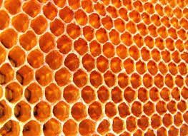
Patterns
Observed patterns in nature guide organization and classification, and prompt questions about relationships and causes underlying them.

Slide 7
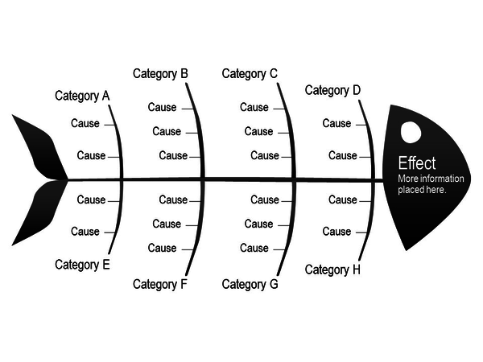
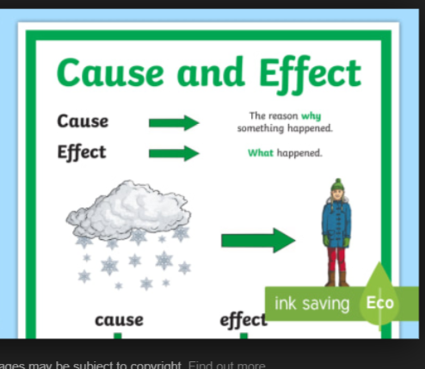

Cause and Effect
Events have causes, sometimes simple, sometimes multifaceted. Deciphering causal relationships, and the mechanisms by which they are mediated, is a major activity of science and engineering.

Slide 8
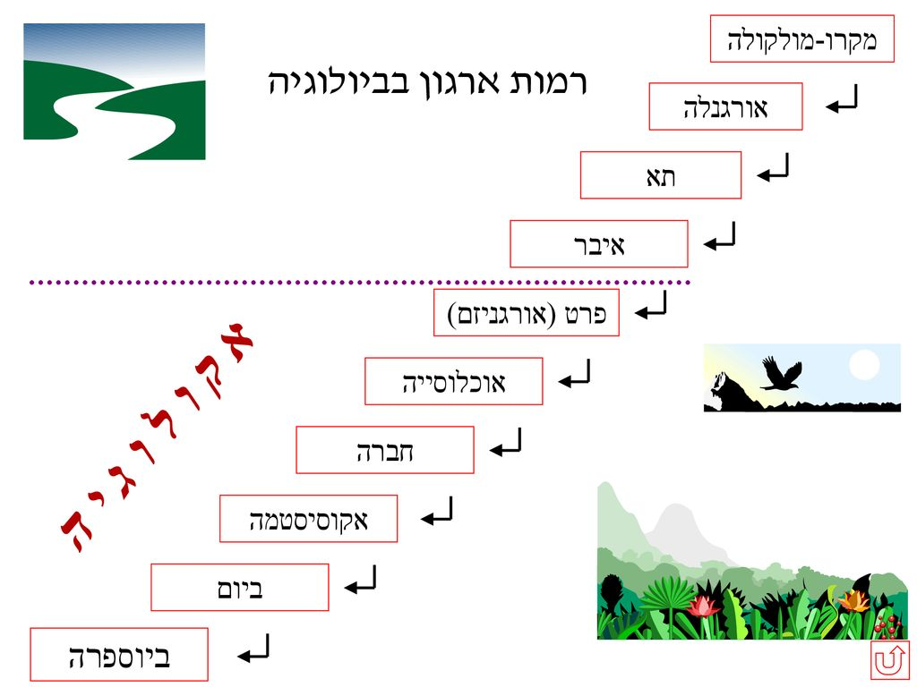
Scale, Proportion, and Quantity
In considering phenomena, it is critical to recognize what is relevant at different size, time, and energy scales, and to recognize proportional relationships between different quantities as scales change.

Slide 9
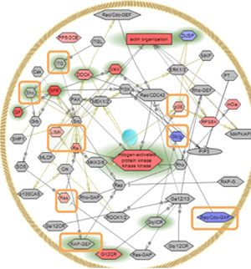
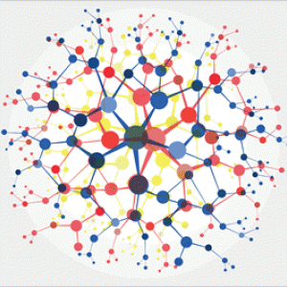
Systems and System Models
A system is an organized group of related objects or components; models can be used for understanding and predicting the behavior of systems.

Slide 10
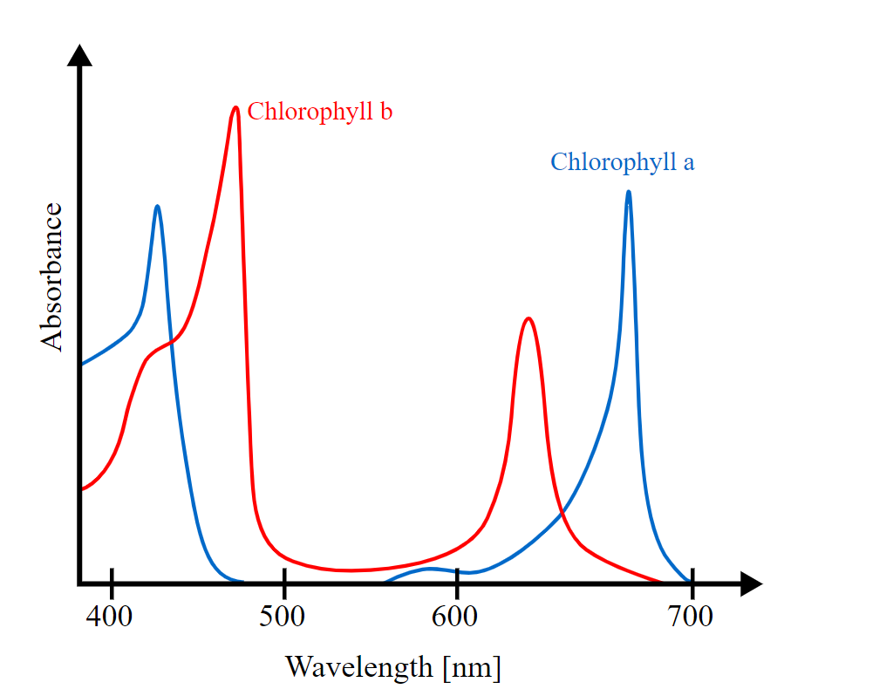
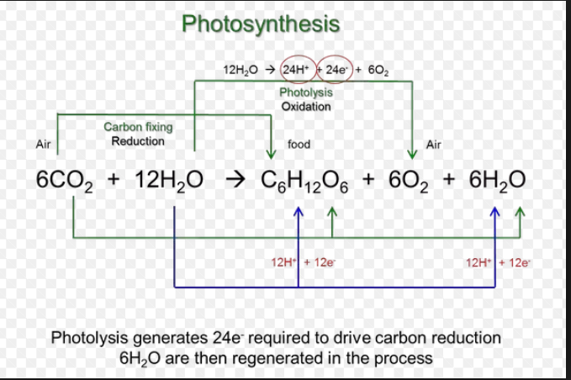
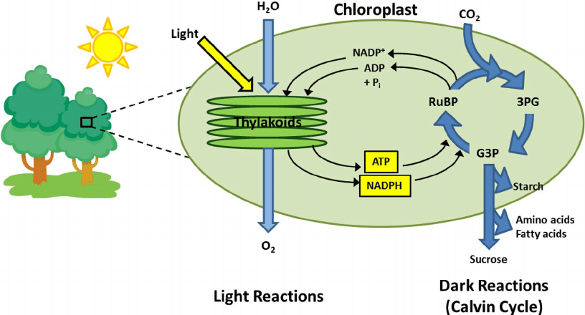
Energy and Matter
Tracking energy and matter flows, into, out of, and within systems helps one understand their system’s behavior.
The energy (e) of a photon is given by the equation e = hc/λ, where c is the velocity of light, h is Planck’s constant, and λ is the light wavelength. The energy (E) of an einstein is E = Ne = Nhc/λ = 28,600/λ, when E is in kilocalories and λ is given in nanometres (nm; 1 nm = 10⁻⁹ metres). An einstein of red light with a wavelength of 680 nm has an energy of about 42 kcal. Blue light has a shorter wavelength and therefore more energy than red light. Regardless of whether the light is blue or red, however, the same number of einsteins are required for photosynthesis per mole of oxygen formed. The part of the solar spectrum used by plants has an estimated mean wavelength of 570 nm; therefore, the energy of light used during photosynthesis is approximately 28,600/570, or 50 kcal per einstein.

Slide 11
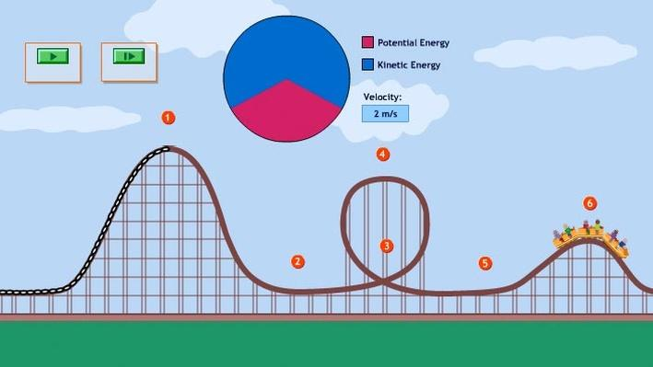
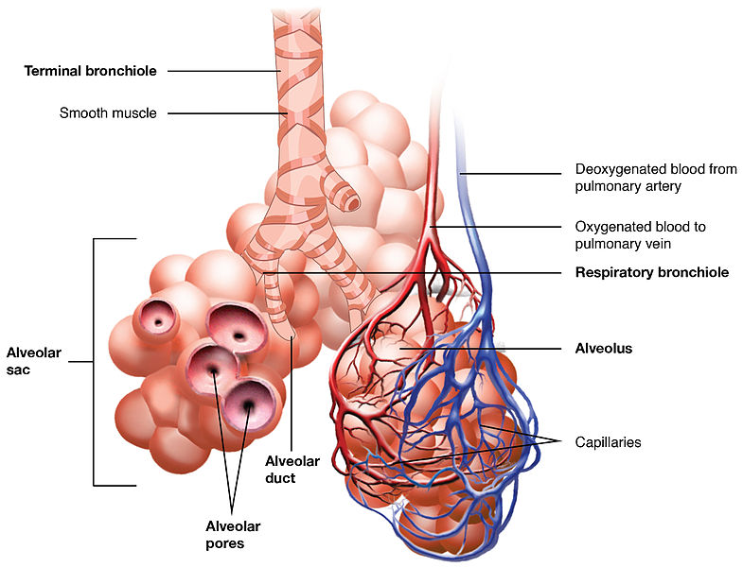
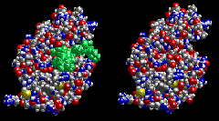
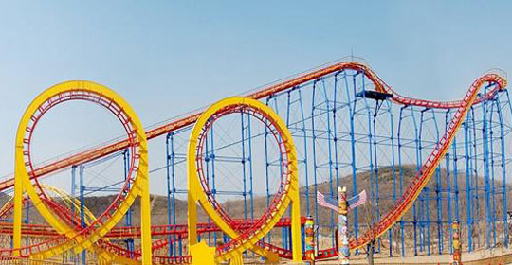
Structure and Function
The way an object is shaped or structured determines many of its properties and functions.

Slide 12
Stability and Change
For both designed and natural systems, conditions that affect stability and factors that control rates of change are critical elements to consider and understand.
לאתר NGSS

Slide 13
חומרי למידה
לחומרי ימי למידה באתר מוטנט
ונעבור לסדר היום....

